Slide 1

Incorporating Stigma and Discrimination issues into Academic Medical and Health Care Worker Training
A/Prof Levinia Crooks AM
Chief Executive Officer - Australasian Society for HIV, Viral Hepatitis and Sexual Health Medicine (ASHM)
Adj A/Prof Public Health and Human Biosciences, La Trobe University
Adj/A Prof Centre for Social Research in Health, University of NSW

Slide 2
Acknowledgements and Conflicts
Mr Scott McGill and Mr Ostap Kornev have contributed to the development of this paper and the ASHM Removing Barriers Project
I have no conflicts in relation to this presentation or this project

Slide 3
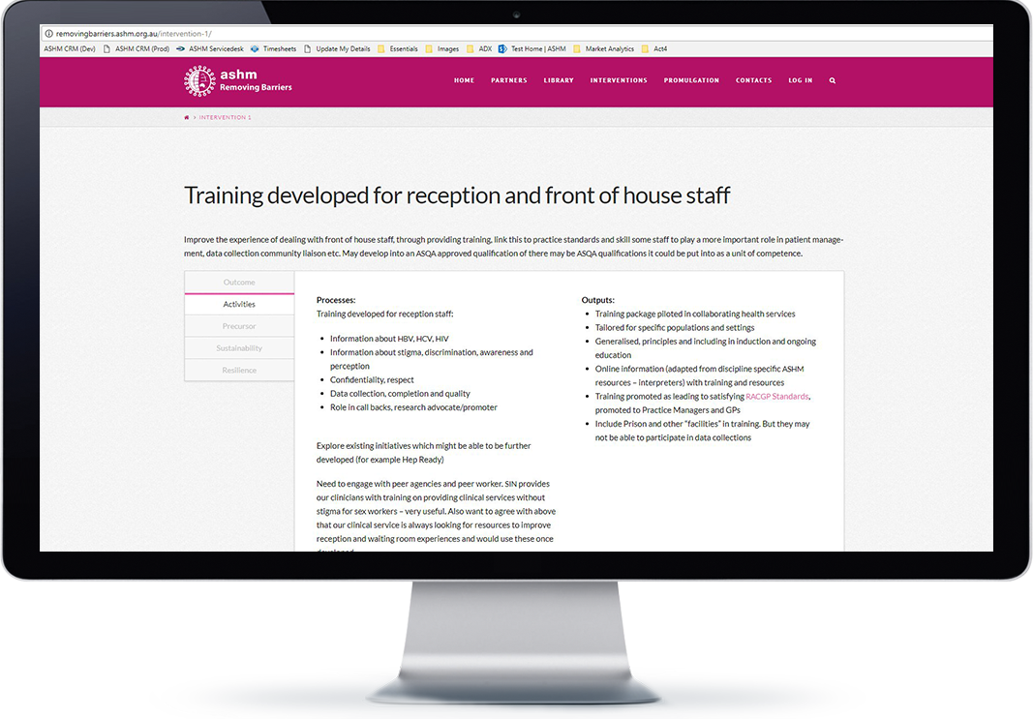
Stigma, Discrimination and Structural Barriers
Commonwealth funded 2 year project to develop training interventions and make these sustainable
Reduce stigma, discrimination and structural barriers to people living with or at risk of HIV and/or viral hepatitis from accessing health services
http://removingbarriers.ashm.org.au/
Notes:
The Project, Removing Barriers is a 2 year commonwealth department of health funded project to reduce stigma, discrimination and structural barriers in health services which impede people living with or at risk of HIV and/or hepatitis C from accessing health services for prevention, diagnosis and treatment services. The interventions are supposed to be sustainable and available on-line. We are just entering the second year of the project and have go through a broad consultation to identify areas of need and explore how the interventions can be developed in such a way as to make them sustainable. That involves working with colleges, professional organisation and training institutions as well as employers to make sure that these issues are recognised as important in included in training curricular and standards.
Using a website for project communications with holding images which will go live later this year and hold project resources

Slide 4
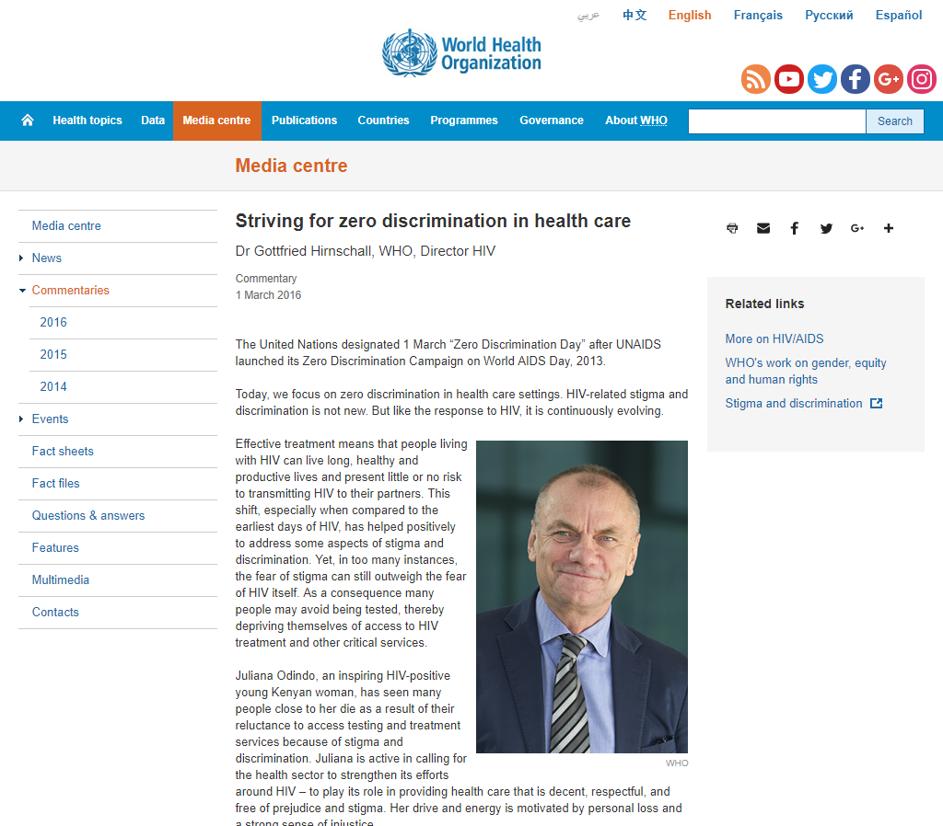
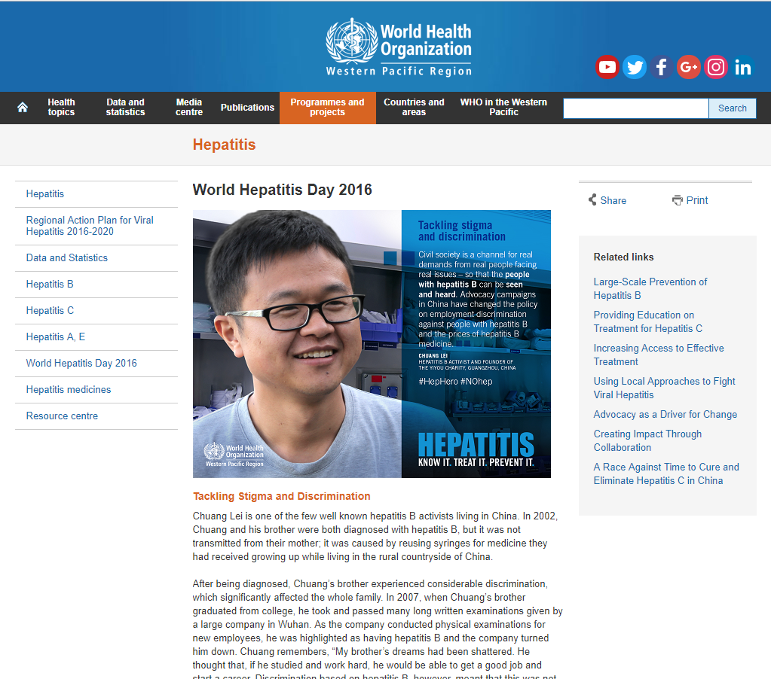
Stigma, Discrimination and Structural Barriers
Stigma, and resultant discrimination identified by the WHO as the major impediment to elimination of HIV and viral hepatitis
Notes:
Stigma and the resultant discrimination, has been identified as a global impediment to achieving the elimination of HIV and viral hepatitis. At a very high level Goal 16 of the World Health Organisation Agenda for Sustainable Development, calls for inclusive societies that promote non-discrimination. This high level goal is translated into more practical programs such as the zero discrimination campaign launched on World AIDS Day 2013 and zero discrimination in health care launched in March 2016.

Slide 5

Stigma, Discrimination and Structural Barriers
Despite effective treatments people living with hepatitis C are still reticent to come forward for treatment, often because of the stigma associated with HCV
Notes:
This poster is currently being displayed on Sydney buses to encourage people living with HCV to come forward for treatment

Slide 6
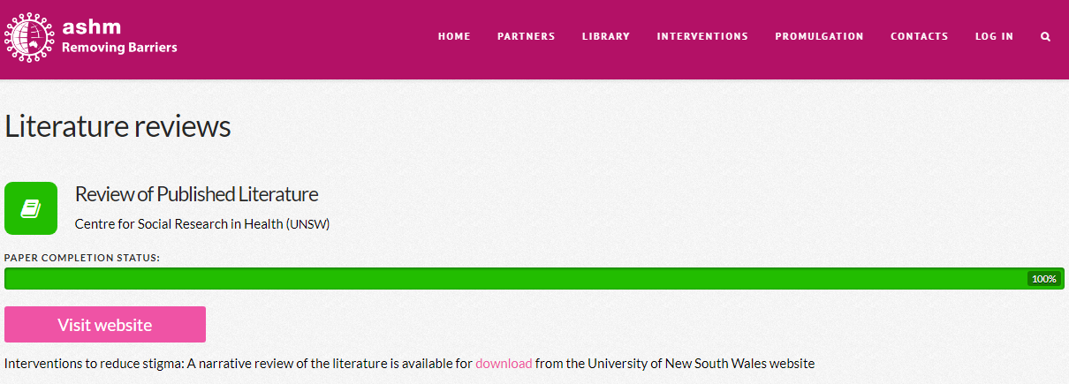
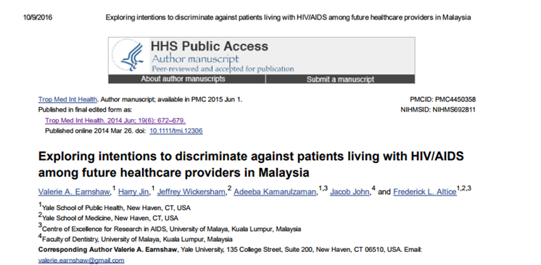
Needs Assessments
There is little published literature on the efficacy of stigma and discrimination projects, though there is considerable material identifying the experience of this.
Literature review
Notes:
The University of Malaya has conducted some research on intention to discriminate among medical and dental trainees, which was found to be high and is planning interventions to reduce this starting in their 2018 year.
Examples of experience (as described in project community submissions):
1. “The test was antibody positive. The GP had shock on his face, he put on some gloves to check my
high blood pressure. He wrote on my notes in red "Hep C positive". I explained to him that I had had
treatment and my PCR will be negative to confirm. He wouldn't listen. He did the PCR and it came
negative but he wouldn't hear of it that I was cured." (Hepatitis Australia)
- need to educate GPs in regard to interpreting tests for HCV and about stigma and discrimination so as to not alienate
people.
2. Sex workers have reported being billed for
mandatory health checks and unrequested sexual health tests at higher rates upon
disclosure of their occupation. (Scarlett Alliance Report)
3. Disclosure of drug use or BBV status led to their being discriminated against. (Australian Injecting & Illicit Drug Users League)

Slide 7





Community Consultations
Consultation reports from peak and community organisations working in HIV and viral hepatitis

Slide 8


Planning and Prioritising
Partners agreed to work with the project, gather information and contribute to planning
Implementation partners have worked with the Project to look at how initiatives can be implemented in such a way that they are sustainable and taken up by relevant institutions
Notes:
The foundation partners, listed here are those who signed up to the project at its outset. As the project has progressed, additional partners have come on through working groups and/or a desire to participate in pilots or the rollout of interventions.

Slide 9


Planning and Prioritising
The Australian Hospital and Healthcare Association facilitated a planning day and produced a report to guide year 2 of the project
Learn more at http://removingbarriers.ashm.org.au/

Slide 10
Training priorities and policy priorities
Reception and front of house/clinical service staff
Nurses, Practice Nurses and other professional organisations of nurses
Medical practitioners and other healthcare professionals in training
RACGP Practice Standards
Cost of Opioid Substitution Therapy
Data completeness (for data held in medical records)
Management of HCW living with a BBV (promulgation of CDNA policy)
Patient and community facing activities to support resilience
Notes:
The following priorities were identified through the planning process and in the report. These have been agreed by the funder.
in relation to the CDNA policy, it will be important to make sure that health services are aware of their new and changing obligations in relation to the employment and support of HCW living with a BBV. But we are working closely with CDNA in this regard and will help promote these changes through ACHSM and other professional organisatons as soon as they are approved by COAG as they are nationally applicable.
while HCW behaviour in health services is crucial, there is also a responsibility on patients to assert their rights and to be empowered to do this. Community agencies are very well placed to assist with this and to highlight those strategies which work. Including encouraging patients to make complaints where necessary.
The rest of todays talk focuses on medical practioner and other Health care professionals in training

Slide 11
Our aim
Raise the importance of stigma and discrimination in health care in relation to all issues HIV, viral hepatitis, drug use, GLBTI populations, indigenous communities, disability, cultural and linguistically diverse groups, gender and age
Promote the importance of this through professionals and their organisations
Provide resources and support to institutions and organisations to take up these issues
With the outcome of experiencing greater inclusion and access and improved health
Notes:
Our aim is to raise the importance of stigma and discrimination in health care in relation to all issues HIV, viral hepatitis, drug use, GLBTI populations, indigenous communities, disability, cultural and linguistically diverse groups, gender and age. We are not looking to specifically draw out HIV and viral hepatitis, but rather to use these as example and to raise principles around stigma and discrimination more generally
As we are trying to make these initiatives sustainable we are hoping to promote the importance of this through professionals and their organisations such as this meeting
We recognise that training curricula and programs are full and broad and that is why we are taking a long-term approach and working with Sydney university and others to see how these issues can be included in teaching programs in a structural and coordinated way drawing together related issues and using examples and cases relevant to different students and locations. Rather than as stand alone add on which may have come about because of a particular individuals interest or something like a WHO year of the campaign
Through this program we have capacity to provide some online resources and support to institutions and organisations to take up these issues. With the outcome of experiencing greater inclusion and access and improved health

Slide 12
Graduate Outcomes of relevance: Domain 3
On entry to professional practice, Australian and New Zealand graduates are able to:
3.1 Accept responsibility to protect and advance the health and wellbeing of individuals, communities and populations.
3.2 Explain factors that contribute to the health, illness, disease and success of treatment of populations, including issues relating to health inequities and inequalities, diversity of cultural, spiritual and community values, and socio-economic and physical environment factors
Notes:
While Domain 3 from the AMC(Australian Medical Council) Standards for Assessment relate to broad societal issues they are not specific to stigma and discrimination, which could easily get lost in these wider definitions.
Indigenous populations are covered explicitly under other sections within section 3 but cultural diversity and cultural sensitivity appears not to extend to other cultural groups, many of whom are adversely and impacted and impacted at a much higher level by some transmissible BBV, such as hepatitis B, hepatitis C and HIV.

Slide 13
Time changes and ad hoc program inclusion
Domains 3.1 and 3.2 while potentially inclusive of disability, age, gender, GLBTI, BBV and drug use
Do not necessarily respond in a timely manner to changes in migration, nor the other population or community based issues
Student placements and the practical observation of discriminatory practices in the clinical setting can reinforce these practices and students report they are unsure of how to challenge or raise these issues in placements
Placements in specific clinics (such as high caseload HIV GP clinics, Hep C clinics or immunology clinics) may provide exposure to culturally aware practices, there is no guarantee all students will get this exposure
Notes:
Migration, refugee and resettlement programs are constantly changing and it is important that medical training programs are sufficiently agile to respond to these changes, and the challenges they bring, through regular review. Teaching to principles, and including temporally and geographically relevant cases and scenarios can assist with this.

Slide 14
UTAS and Sydney University Programs
The University of Tasmania has run, lectures on social determinants of health (inc. discrimination), public health dilemmas, sexuality and gender, diversity and 6 workshops over a 3 hour period
The Sydney University immunology program has included a lecture on HIV from a lived experience perspective
Notes:
The Tasmania program has been well evaluated by participants and the workshops cover
Lived experience,
historical timeline,
parents/children and gender diversity,
barriers to accessing services,
BBV and stigma
values and myths
People from the relevant communities, people living with BBV, members of the GLBTI community and sex workers have all been involved in training.
The Sydney University lecture also included community representatives and when a heterosexual speaker was included there was some feedback from students that they thought it should have been a gay man to better reflect the community most affected by HIV.
The use of short videos can help address these issues and can supplement face-to-face exposure to affected communities.

Slide 15
Lecture outline – then translated to online format
Discussion of the pre-lecture exercise: (10 minutes)
Interactive exercise: (20 minutes)
General discussion of stigma and discrimination - mini lecture: (15 minutes)
Case Studies:
Disability – (15 minutes)
Drug use – using an HCV example – (20 minutes)
Ethnicity/Culture – using an HBV example – (15 minutes)
Transgender – recognizing transgender persons and understanding sexuality – (15 minutes)
Adolescents/young people – sexual health, STI, contraception, abortion – (15 minutes)
MSM – HIV diagnosis and prevention (PReP) – (15 minutes)
Closing discussion and evaluation (10 minutes)
Notes:
Students will have the option to view an on-line scenario based exercise which looks at stigma and discrimination in the health setting.
This will be discussed at the beginning of the lecture (those who have not viewed it will not be disadvantaged .
We have an interactive exercise which had been run in a number of settings in Australia and with a regional group in Singapore, asking participants to prioritise patients to a full clinical list based on certain features. This is done twice where in the first instance students are given demographic features in the second run through they are provided with a set of more value laden characteristics, a drug user, a sex worker a transgender woman and man who has sex with men etc. They allocate priorities and are then shown their comparative data. What they know about the patient clearly influences the priority awarded to the patent in the list. This is done using phones or voting pads and the data is not matched to the participants, it is purely to show that we are all influenced by what we know or think we know.
Case studies will use “real people” in the lecture and will be translated to branched scenarios in the on line example. These provide students with feedback as to the consequences of their actions and how diffent behavious will result in different responses from patients (and other staff members). In the on-line format students will be able to run through the examples on a number of occasions to look at the different consequences. The scenario\s are beign developed by consumers and HCW who have been through these settings

Slide 16
Ongoing role for ASHM Program and SHAPE​
We would like to continue to share information through SHAPE​
This includes initiatives for Medical Education, but also how this dovetails with curriculum development including as this moves to cross disciplinary in some settings​
While we believe that there is no exact replacement for face-to-face learning we are exploring on-line options including scenario based learning which we hope goes at least part of the way to providing attitudinal based learning (reflected in clinical experience) rather than just knowledge and skills based learning, which can often be replaced by protocols, guidelines and checklists.

